Slide 1
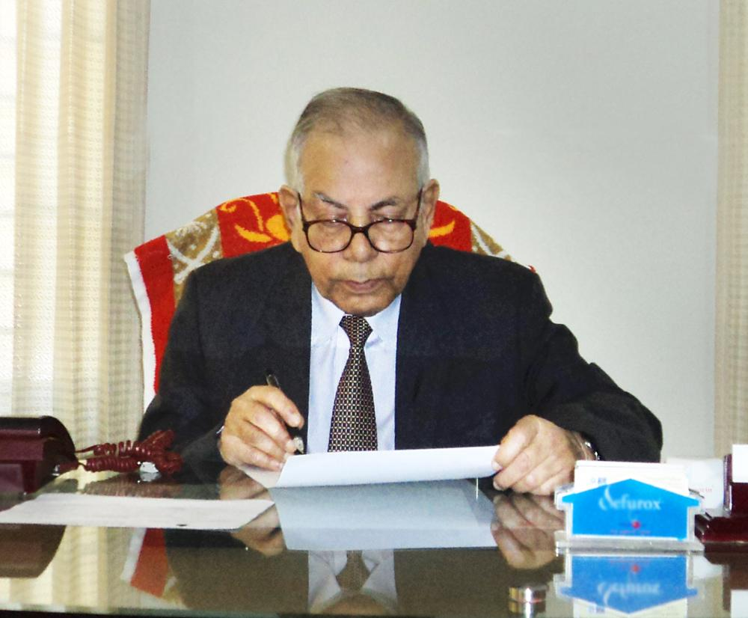
SYLHET DIABETIC HOSPITAL
Message from the Founder President: “I am in a unique position to see this work through. I am not only the hospital's president, but have also witnessed countless scores ravaged by diabetes. I have had several older siblings and other family members, younger than me, die prematurely because of complications of this disease. I too am afflicted and am suffering with the partial loss of my eyesight. And though diabetes can take my eyes, it cannot take away my vision. A vision of an expanded medical care facility better equipped to serve the impoverished people of Bangladesh.”

Slide 2
SYLHET DIABETIC HOSPITAL
Executing and Supplementing of the Existing Departments by December 31st, 2018:
CCU – 8-beds Complete CCU Unit;
NICU – 4-beds NICU be available;
Ophthalmology – Complete Phaco Surgery and Treatment by Macula Degeneration;
Gynecology – C-Section, awareness on obstetric fistula and skilled procedure, Experienced Hysterectomy, Awareness Cervical Cancer and Treatment CIN Stages or Pre-Cervical-Cancer;
Endoscopy – Complete common endoscopy procedures evaluate the esophagus, stomach, and portions of the intestine;

Slide 3
SYLHET DIABETIC HOSPITAL
Executing and Supplementing of the Existing Departments by December 31st, 2018:
All Office Employees including even drivers must be CPR trained;
Update Emergency Unit by WHO Recommended Generic Emergency Medical Equipment;
Make National Accreditation Board for Hospitals & Healthcare Providers Accredited;
NABH Compliant Hospital Management System Software;
Recruit Doctors and Nurses – Full Time Employment by Medicine, Cardiologist, Critical Specialist, Nephrologist, Vascular Surgeon, Ophthalmologist, Pediatrician, Gastroenterologist, Sleep Disorder Specialist;
By Consultants from BIHS and DAB to train new recruits at SDH with specific monthly dates;
Outpatient Work: 8am to 5pm;
Specimen Collection Time: 24 HR;
EC of SDH Visit to TATA non-profit Hospital Kolkata, Saroj Gupta non-profit Cancer Centre Kolkata (formerly known as Cancer Centre Welfare Home & Research Institute), and BIHS Hospital Mirpur for practical exposure on how to organize, discipline, selfless, and dedicated to grow from nascent to massive institutions;
Monthly Accomplishment Report from the EC of SDH to the President of DAB;

Slide 4
SYLHET DIABETIC HOSPITAL
Executing and Supplementing of the Existing Departments by December 31st, 2018:
Steel Pillar and Beam structure will build and support a tin roof for the Sixth Floor;
Shift All Offices From the Second Floor to the Sixth Floor;
100% Utilize all rooms, floors and Ambulances;
Hub (SDH) and Spoke (Upazila and Important Vicinity) - Yearly 12 medical camps – Care on Wheels (COW) - Jaflong, Chathok, Sunamganj, Beanibazar, Moulvibazar, Sreemangal, Barlekha, Companiganj, Zakiganj, Baswanath, Fenchuganj, Golapganj;
Continuing Medical Education Training by Doctors, Nurses and Technologists by every three months through Bangladesh Institute Health Science (BIHS) and Diabetic Association of Bangladesh (DAB);
Bring a Health Economist for Advice;
Submit monthly Newsletter through hardcopy and softcopy;

Slide 5
SYLHET DIABETIC HOSPITAL
Executing and Supplementing of the Existing Departments by December 31st, 2018:
Of Total revenue, 25% from Lab;
Of Total revenue, 25% from inpatient-outpatient;
Of Total revenue, 25% through Zakat,;
Of Total 25% revenue, from Donors and Sponsors;
Yearly Dinner Meeting by Executive Committee to Appeal-Donation for Cash & Equipment by local citizens from Sylhet and rest of Bangladesh, and NRBs from UK and all Countries;
Yearly Lunch Meeting by Life Members to Appeal-Donation for Cash & Equipment by local citizens from Sylhet and rest of Bangladesh, and NRBs from UK and all Countries;
Target Ratio by Operational Expense to Gross Operating Income less than 35% to make sure Hospital is sustainable and support its organic growth;

Slide 6
SYLHET DIABETIC HOSPITAL
Future Expansion Plan by Founder President’s Vision: -
Sylhet Diabetic Hospital should build a new 10-storey building on its unused 0.25 acre land to expand its both outdoor and indoor capacity and for Full Body Digital X- ray, CT Scan, Real Time PCR Machine, Colonoscopy, Lithotripter Equipment, MRI and Mammography machine including the establishment of dedicated neurology department, ophthalmology department, pediatric department, ENT & Head-Neck department, gastroenterology and hepatology department, urology department, bone-joint-trauma department, and neonatal intensive care unit.
This new building will also have nursing and paramedical college at one or of the top floors. Furthermore, basement Parking must be available for around 50-cars
Our Target Budget 50 Crore Taka - Life Members and Executive Committee will Target 10 Crore Taka by Local and Foreign Donors and Sponsors; Rest of the fund through submitting Project Proposal to the Finance Ministry, Social Ministry and Health Ministry
Complete Target by 2025

Slide 7
SYLHET DIABETIC HOSPITAL
Future Expansion Plan by Founder President’s Vision:-
Shift CCU to ICU Unit of Old Building. New Building of two floors - seven and/or eight - for full fledged Cardiac Unit including CCU, HDU, Angiogram and Cardiac Surgery;
Project Proposal Taka 20 Crore - Complete Target by 2030;
Procure 30 Katha land adjacent hospital to establish a medical college, nursing dormitory, cancer centre (Stage-1), burn unit;
Project Proposal Taka 50 Crore - Target by 2035;

Slide 8
SYLHET DIABETIC HOSPITAL
Thank You

Slide 9
SYLHET DIABETIC HOSPITAL
www.sdhbd.org

